Slide 1

Artiﬁcial Intelligence
A Comprehensive Overview
ARAFATH ALI

Slide 2
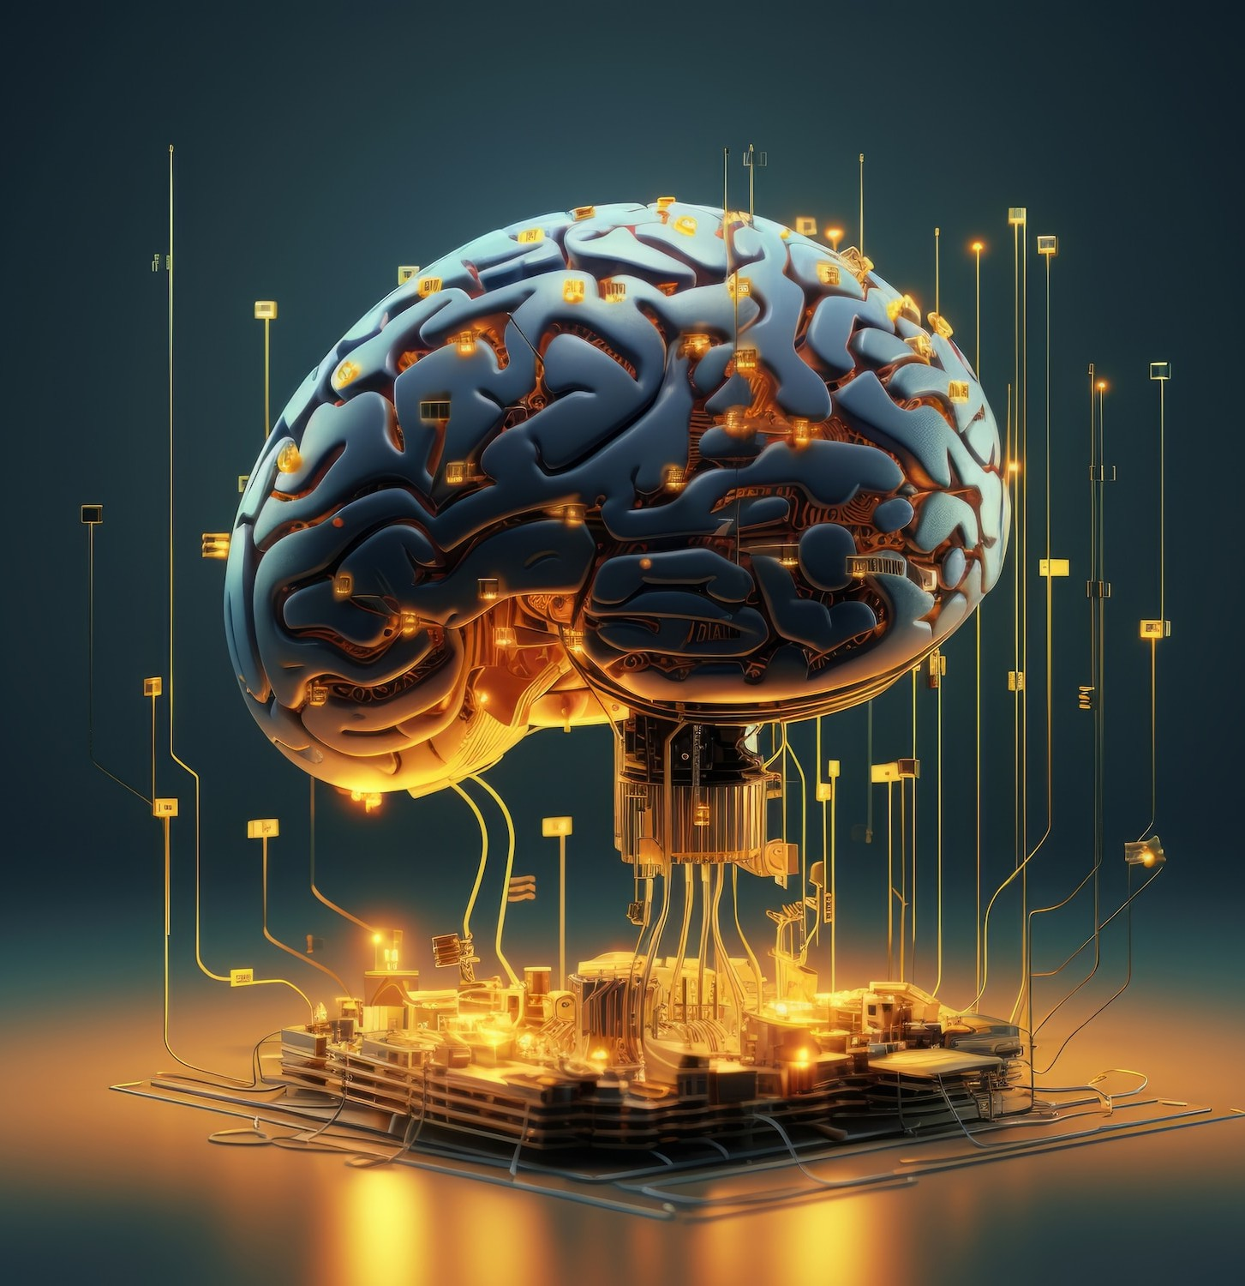
Introduction to AI
Artiﬁcial Intelligence
Understanding AI is crucial as it
plays a pivotal role in various industries. We will cover key concepts, applications, and future trends that shape the landscape of technology today.

Slide 3

History of Artiﬁcial Intelligence
The journey of Artiﬁcial Intelligence began in the mid-20th century. Pioneers like Alan Turing and John McCarthy laid the groundwork for modern AI. Understanding this history helps us appreciate the evolution and breakthroughs that have occurred over the decades.

Slide 4

Machine Learning Basics
At the heart of AI lies Machine Learning. This ﬁeld focuses on developing algorithms that allow computers to learn from data. By identifying patterns, machines can make predictions and improve over time, transforming industries such as healthcare and ﬁnance.

Slide 5
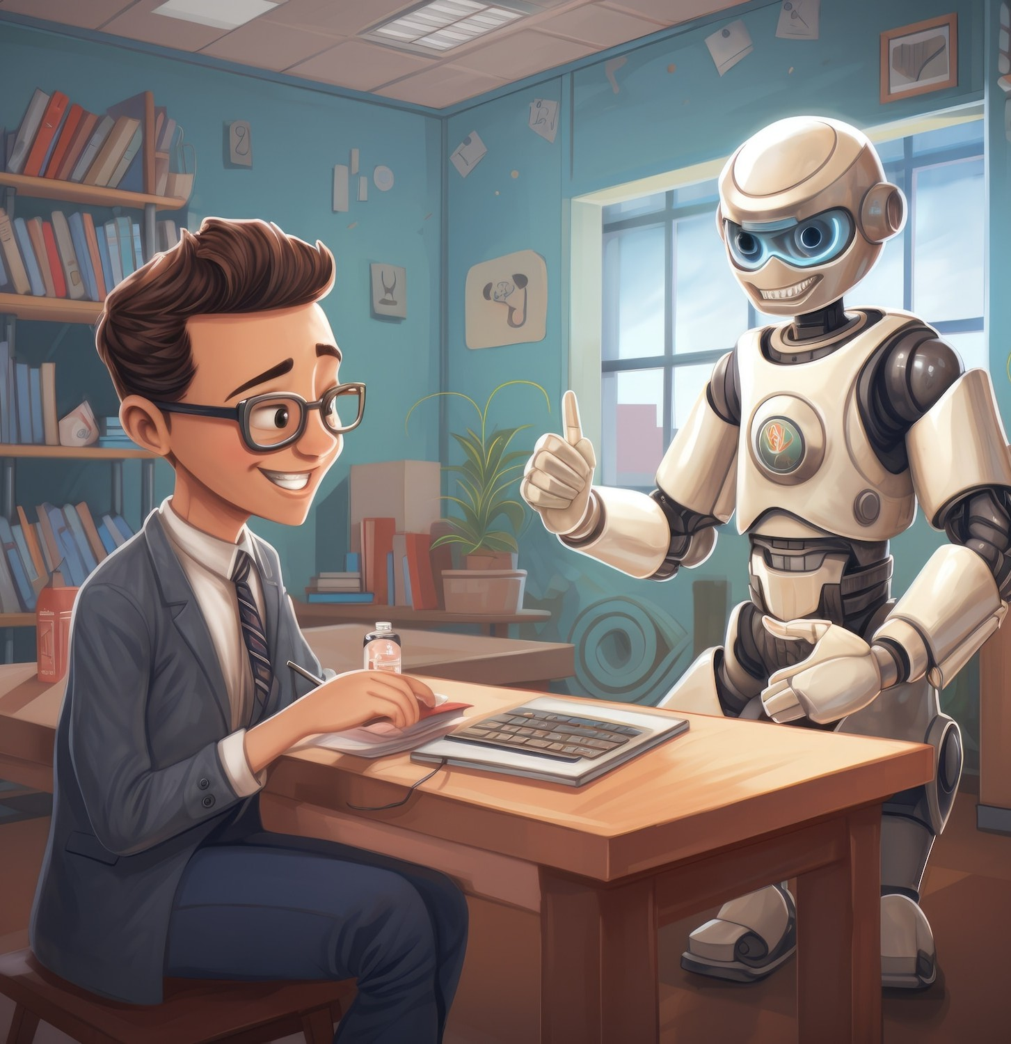
Natural Language Processing
Natural Language Processing (NLP) enables machines to understand and interact using human language. This technology powers applications like chatbots and voice assistants, making communication between humans and machines more intuitive and efﬁcient.

Slide 6

Ethics in AI
As AI technology advances, ethical considerations become increasingly important. Issues like bias, privacy, and accountability must be addressed to ensure that AI systems are developed responsibly. Understanding these challenges is essential for fostering trust in AI.

Slide 7

Conclusion and Future Trends
In conclusion, the exploration of Artiﬁcial Intelligence reveals its vast potential and challenges. As we look to the future, advancements in AI will continue to reshape our world. Staying informed about these changes is crucial for leveraging AI responsibly and effectively.

Slide 8
Thank you

